Slide 1
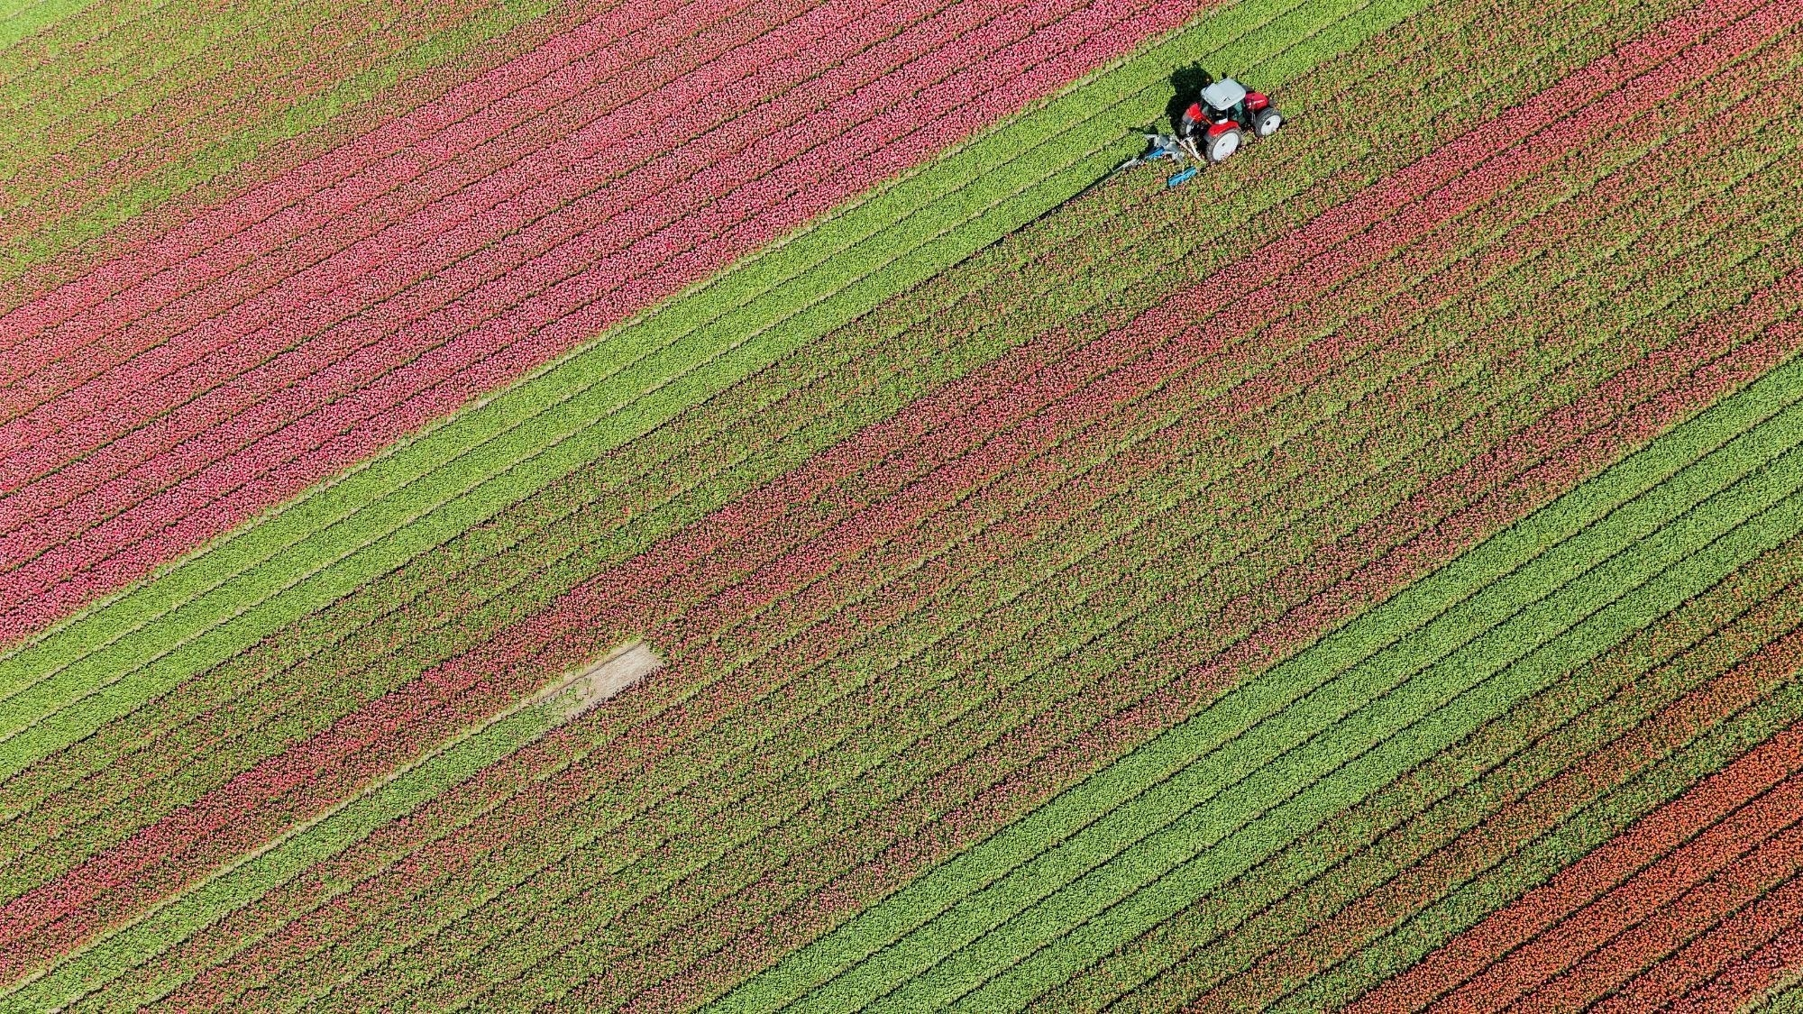
Project -2 CROP PRODUCTION ANALYSIS

Slide 2
OVERVIEW
To create a dashboard using Power BI to track and predict Crop Production in India; and find important insights highlighting key indicators and metrics that influence crop production.

Slide 3
PROJECT KEYPOINTS
Data Collection
Data Cleaning & Wrangling
Data Modeling
Data Visualization
Dashboard Design
Sharing Insights

Slide 4
STEPS INVOLVED IN POWER BI
Load Raw Data from Excel/CSV files
Transform Data using Power Query
Report View to analyze data
Table view to modify/manipulate data as per requirements
Model View to establish a relationship between source data

Slide 5

PROJECT LEARNINGS
Created an interactive dashboard to track and analyze online sales data
Used complex parameters to drill down in a worksheet
Used different types of customized visualization (bar chart, pie chart, donut chart, clustered bar chart, line chart, etc)

Slide 6
DETAILS OF DATA
STATE NAME
DISTRICT NAME
CROP YEAR (1997-2015)
SEASON
AREA
PRODUCTION
NAME OF CROP

Slide 7
MAIN KPI’s
Production – how much crop is produced
Area – how much land is used for cultivation
Crop Yield – Efficiency of crop measured by the above two factors

Slide 8
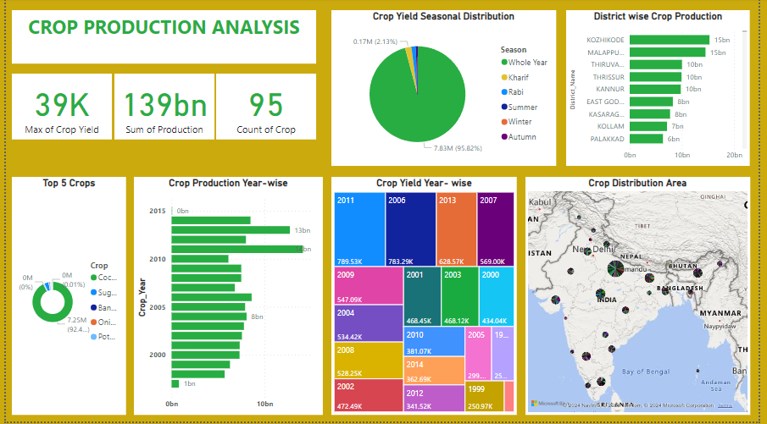
REPORT

Slide 9
INSIGHTS
Max Crop Yield – 39K
Total Production – 139bn
Crop Variety – 95
Top Crop – Coconut
Max Crop Production year – 2011
Top Performing District – Kozhikode
Top state – Uttar-Pradesh

Slide 10
Thank You

